Slide 1
Python Unit Tests with Code Coverage Information
With modules unittest and coverage
Jack Xue
2022-05-06

Slide 2
Install module coverage & Coding
The module unittest is preinstalled in python 3.x
We need to pip3 install coverage
We need to add a class unit_test.py
import unittest
from io import StringIO
from unittest.mock import patch
class ServiceUnitTest(unittest.TestCase): def test_case_1(self):
self.assertIsNotNone(msi)
if __name__ == '__main__':
# Run the main unittest code
unittest.main()

Slide 3
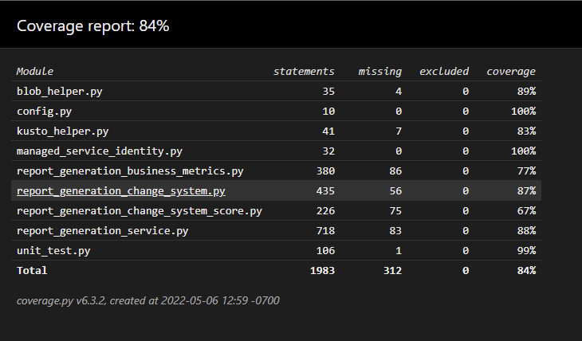
Test and Result
Run the unit-test.py
> coverage run -m unittest unit_test.py
After the run finished, we can generate reports in HTML (json, xml)
> coverage html
The results will be saved in folder ./htmlcov
Index.html is a code coverage summary report

Slide 4
Useful links
A Quick Intro to Test Coverage in Python | by K. N | Python in Plain English
Python unittest Module – AskPython
unittest — Unit testing framework — Python 3.10.4 documentation

